Slide 1

Opening a Chinese Restaurant in DC
By: peter Guo

Slide 2
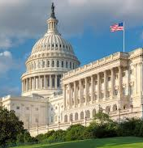
Background
Washington DC has always been one of the busiest places in the United States. With two major airports less than an hour away from each other, tens of thousands of people come and go every day. The Nation's Capital is filled with people all over the country to see the best sites. For business owners, this can be seen as an easy win- if they know where to put their restaurant. In order to maximize their revenue, these owners must pick the best place in the city to build. Many factors are taken in account when they make the decision on location: type of restaurant, closest landmark, accessibility, crime rates, competitors nearby. The decision to open up a restaurant in DC can cost up to a couple hundred thousand dollars, so making the best educated decision will help owners achieve their goals. With this Capstone, we will be examining the factors that affect restaurants and help owners decide the best place to start their business.

Slide 3
Problem
Determining the best place to open up a Chinese Restaurant in DC based off of certain factors
Proximity to landmarks
Crime Rate
Other similar restaurants
Tourism density
Data provided from dc.gov and Foursquare. Geo Json of DC’s 8 wards provided by http://data.codefordc.org/dataset/dc-wards-map-overlay/resource/8ca2fd50-06cc-497f-89f9-a7937ff3650d?inner_span=True
DC is broken down into 8 wards, which we will come in handy later.

Slide 4
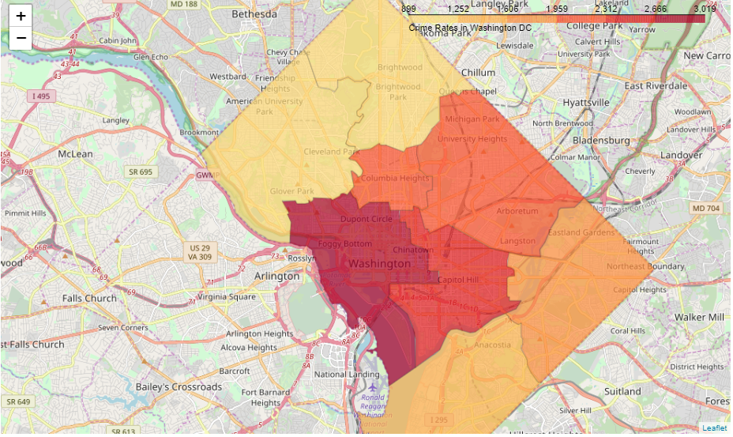
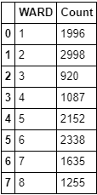
Crime Data
2019 Crimes in each ward
Crimes displayed on choropleth map

Slide 5
Crime Rate Data Explained
This was the first step in the data analysis. I wanted to incorporate this in the data analysis because I wanted to see the relationship between crime and businesses. After cleaning the data and grouping it by ward, it showed that ward two (the national mall) had the highest amount of crimes of 2998, shortly followed by capitol hill of 2338 crimes. This data did not come as a surprise to me as I knew that crimes were going to be high in these areas due to the amount of tourism there every day of the year. Tourism is good in the fact that there will always be an influx of individuals there, staying short term and most likely needing a place to eat.

Slide 6
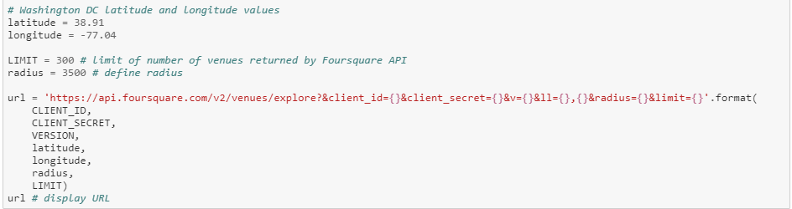
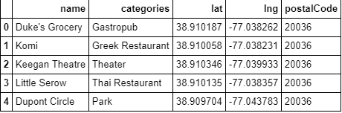
Foursquare venues in dc Query
Sample result of dataframe after cleaning the data

Slide 7
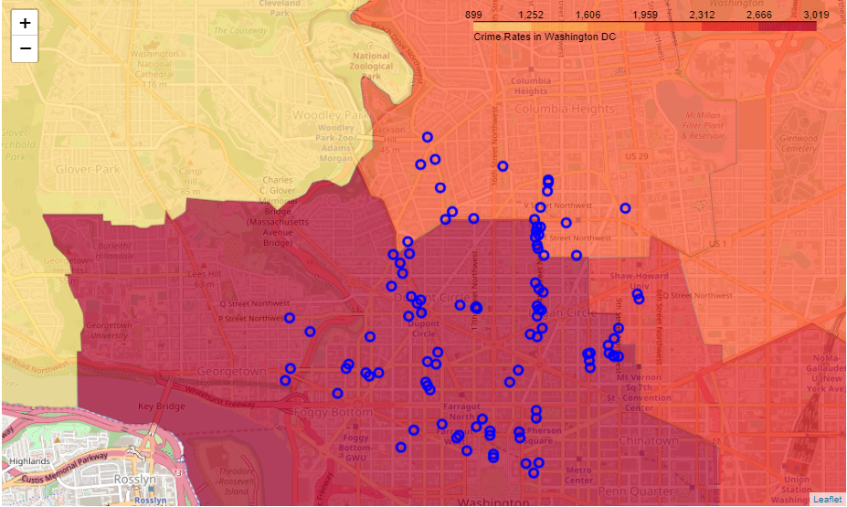
Venues mapped on choropleth map
The return I received had a plethora of different businesses (parks, hotels, grocery stores, restaurants etc..). I had to clean the data and then was able to display it on a choropleth map as seen on the notebook. When it was displayed, it was immediately apparent that the majority of these venues were downtown (ward 2) by the national mall. It coincided with my observation that tourism brings crimes, but attracts a lot of good business.

Slide 8
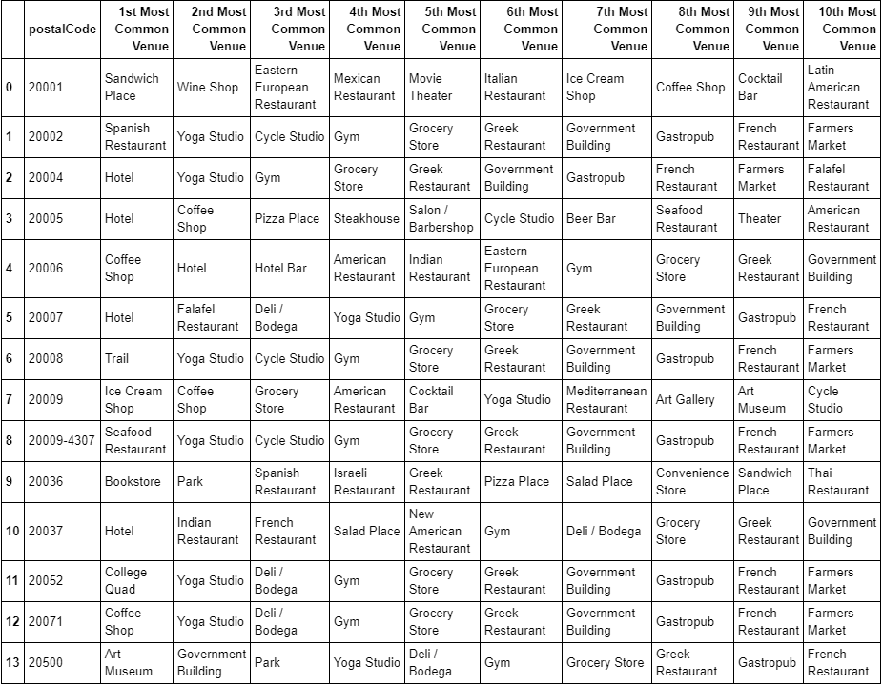
Top ten business categories in zip code
A lot of zip codes in downtown DC seem to be hotels! Next we are going to do a K-Means Clustering to examine the businesses closer.

Slide 9
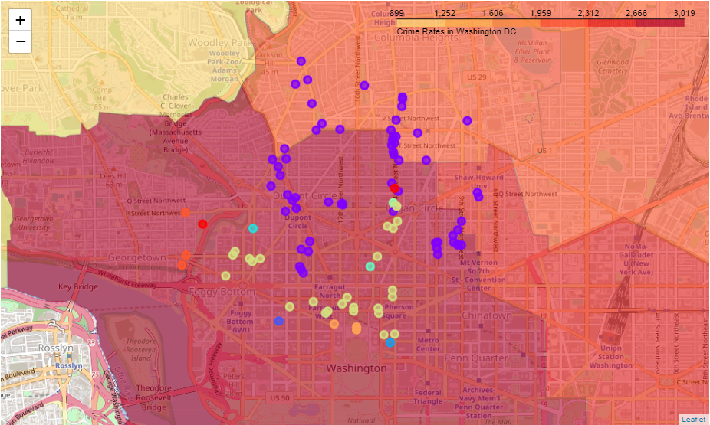
K=10 K-Means Clustering
What we can see above is that the concentration of most businesses is directly related to the crimes committed. Below I will display all the businesses within each cluster and dive into the information to help us determine the best place to put our restaurant.

Slide 10
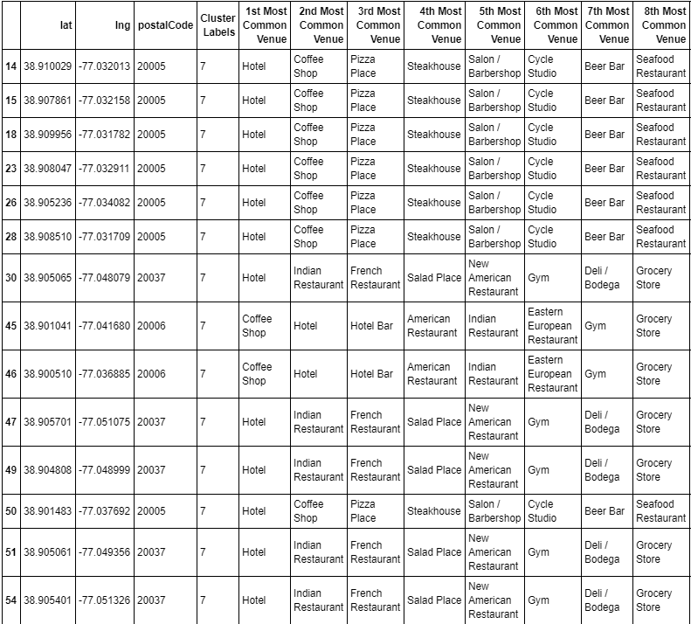
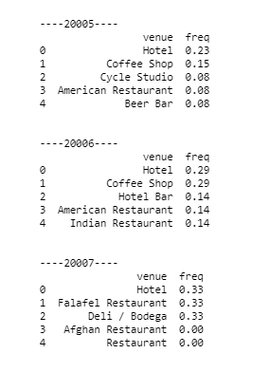
Cluster 7
After seeing the result of the K-Means cluster, the area around McPhearson square, cluster 7 seemed intriguing. As I hypothesized before, there is a high amount of businesses in that cluster, specifically area code 20005, 20006, 20007. The amount of hotels in each of those area codes is 23%, 29% and 33% respectively. That's a lot of hotels! This area is a great area to start a business.

Slide 11
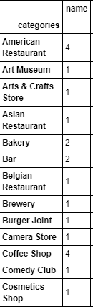
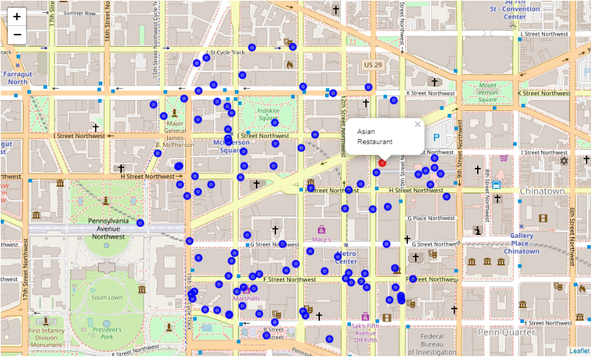
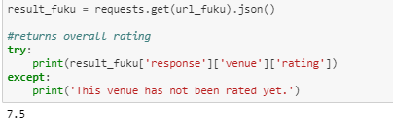
Businesses in Cluster 7
Only 1 Asian Restaurant in Cluster 7 (McPherson Square)! Plenty of room to put a Chinese restaurant here and profit! The restaurant is called Momofuku and has a 7.5 rating. We can compete!

